Slide 1

CLIC BAIT

Slide 2
Prevent cancer from the destroying the lives of young people
“
”

Slide 3
Connection
Escape
Positivity
Accessibility

Slide 4
Decision-based story game

Slide 5
DEMO

Slide 6
Feature
Multiple Endings
Value
Replayability

Slide 7
Future
Swiping Mechanism
Additional scoring metric
More game stories
Upgrading graphics to 3D open world design

Slide 8
Timeline
Decided on
Flask Framework
Added Chat
Functionality
Git Merge Broke
Functionality
React Native fails
Fallback to ReactJS
Core App Runs
Added
Start Screen
Ideation of Game
Features and Format

Slide 9
Technology

Slide 10
Thank You

Slide 11
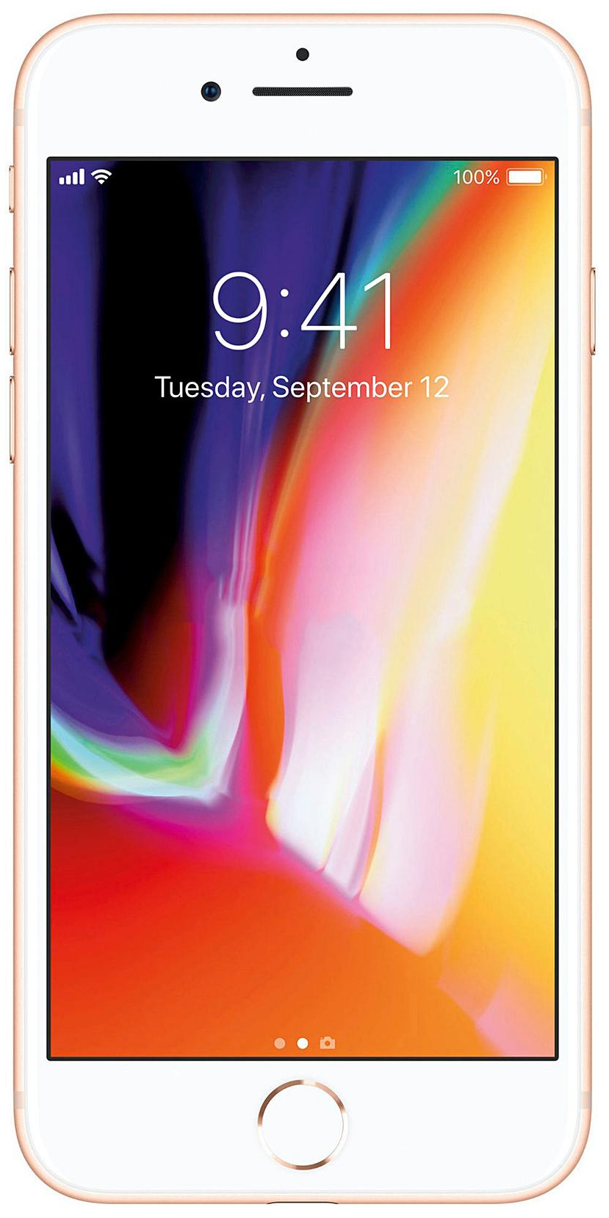
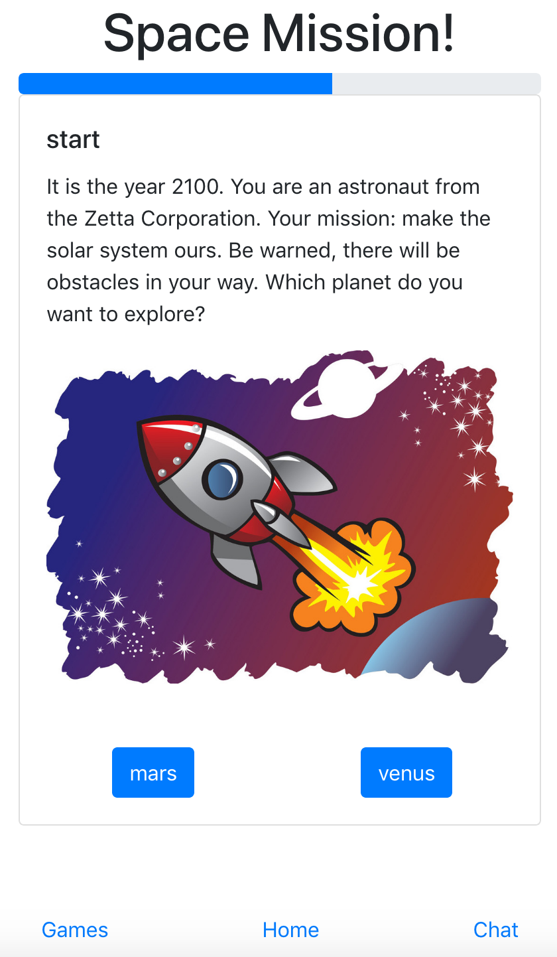
Story Line
Reputation
Character
Simple decision
making
In-game
communication

